Slide 1
Secular Stagnation: A Supply-Side View
Robert J. Gordon
Northwestern University and NBER
Conference on Secular Stagnation and Growth Measurement
Paris, January 16, 2017

Slide 2
Origins of Secular Stagnation on the Supply Side
Secular Stagnation: slow not no growth
Sources emanate from supply side:
Hansen in 1938: slowing population growth
Today 2015: slowing potential GDP growth
1974-2004: 3.12% 2004-2015: 1.56%
Potential Output per Hour
Potential Hours of Work
Working-age Population
Labor-force Participation Rate (LFPR)
Difference for Hansen: Productivity growth in late 1930s was very fast, hence his concern about population growth

Slide 3
Why Secular Stagnation Matters
Direct AS Effects: low productivity growth, declining LFPR reduce growth in output per capita
Indirect Effects: any source of slow potential output growth reduces net investment
Basic idea: steady state with fixed long-run capital-output ratio
Slower output growth means slower growth in capital
Lower net investment: reduces aggregate demand and feeds back to lower productivity growth
Hansen 1938: the AD channel from population
Today 2015: the AS channel from LFPR and slow productivity growth

Slide 4
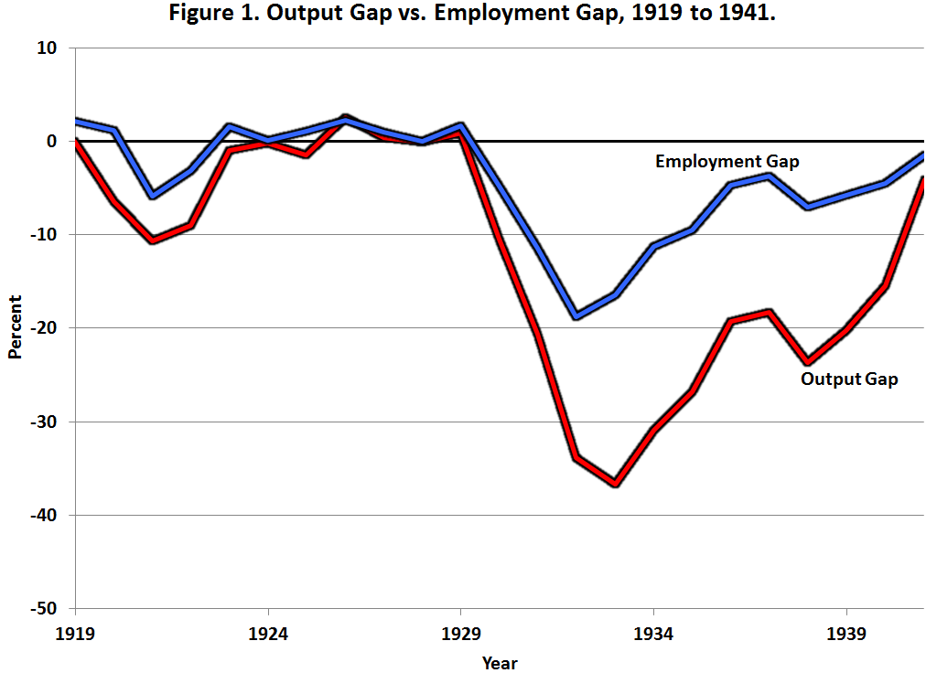
For Hansen the Problem Was Inadequate Aggregate Demand

Slide 5
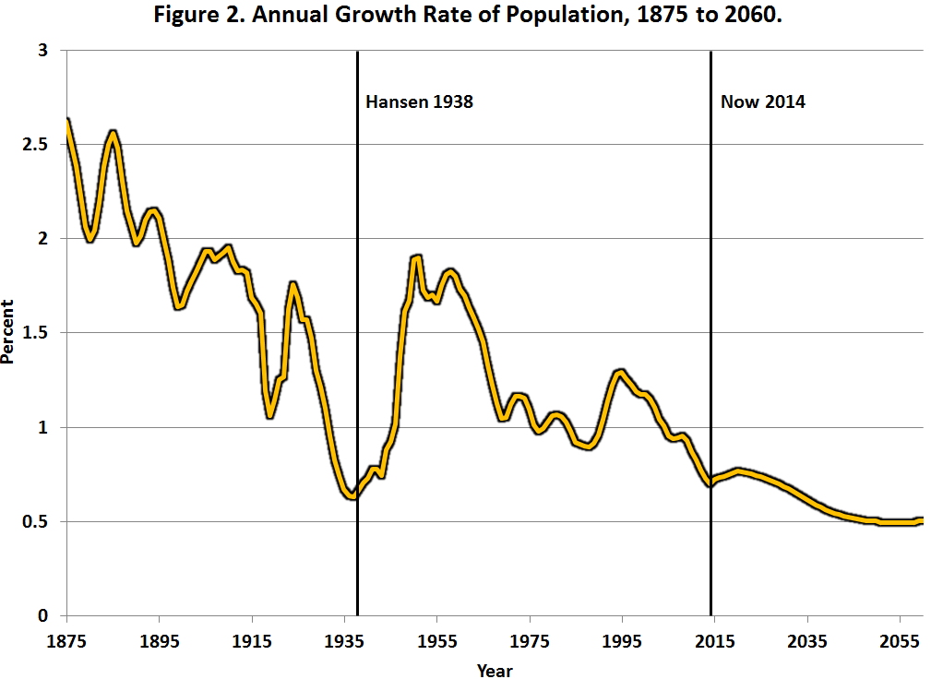
Population Growth 1875-2060

Slide 6
Why Hansen Wasn’t Worried About Productivity Growth

Slide 7
Slowing Productivity Growth As a Source of Secular Stagnation
The best organizing principle to think about innovation is to distinguish among the industrial revolutions (IR #1, IR #2, IR #3).
The 1st IR occurred 1770-1840, continued impact through 1900
Steam engine, railroad, steamships
Cotton spinning and weaving
Transition from wood to steel

Slide 8
The 2nd IR occurred 1870-1920, continued impact through 1970
Electricity, light, elevators, machines, air conditioning
Internal combustion engine, vehicles, air transport
Telephone, phonograph, movies, radio, TV
Running water, sewer pipes, and the conquest of infant mortality
Chemicals, plastics, antibiotics, modern medicine
Utter change in working conditions, job & home

Slide 9
Third Industrial Revolution
Since 1960 the “EICT” Revolution
Entertainment: the evolution of TV from color to time-shifting and streaming
Information Tech – the evolution from mainframes to PCs, the web, and e-commerce
Communications: mobile phones, smart phones
Productivity enhancers: ATM, bar-code scanning, fast credit card authorization

Slide 10
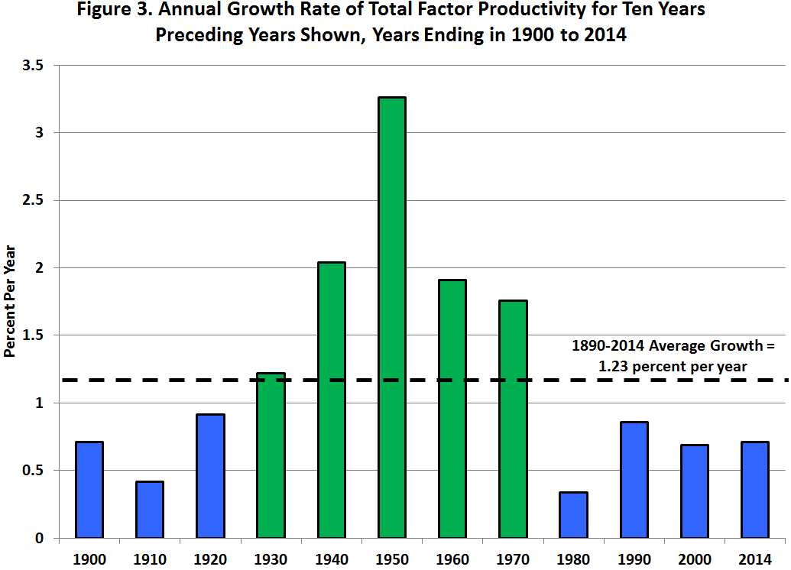
The Powerful But Delayed Impact of IR #2 on TFP Growth

Slide 11
Kalman Trends of Labor Productivity and TFP, Private Economy, 1948-2016

Slide 12
IR #3 Has Failed the TFP Test
Failure #1: TFP growth post-1970 barely 1/3 of 1920-70
Failure #2: IR #3 boosted TFP growth only briefly 1996-2004
STARTLING QUESTON: HAS MOST OF THE PRODUCTIVITY IMPACT OF THE THIRD INDUSTRIAL REVOLUTION ALREADY HAPPENED?

Slide 13
The IR #3 Changed Business Practices Completely 1970-2005
Transformation in offices completed by 2005.
1970 mechanical calculators, repetitive retyping, file cards, filing cabinets
1970s and 1980s. Memory typewriters, electronic calculators, PCs with word processing and spreadsheets
Late 1980s. E-mail, interconnected PCs within firms
1990s. The web, search engines, e-commerce
2000-05 flat screens, home broadband, revolution in business practices was over

Slide 14
The IR #3 Changed Business Practices Completely 1970-2005
Transformation in retailing completed by 2005
1980s and 1990s Wal-Mart led big box revolution in supply chain, inventory management, dynamic pricing
Check-out revolution: bar-code scanners, credit/debit card authorization technology

Slide 15
More Achievements Completed by 2005
Finance and Banking
1970s and 1980s, ATM machines
1980s and 1990s. Transition from multi-million share trading days to multi-billion share days

Slide 16
Large Sectors Not Contributing to Productivity Growth
Medicine
Electronic medical records are here
But they have not replaced either doctors nor nurses, complements not substitutes
Education
Little impact so far of on-line learning in elementary, secondary, or higher education
Cost inflation due to bloat of administrative staff

Slide 17
Innovations Continue But How Important Are They?
3-D Printing
Greatly speeded up speed and efficiency of designing prototypes, not mass production
Robots
Robots date back to 1961, by mid-1990s were welding and painting auto bodies
Robot description from NYT

Slide 18
Innovations Continue But Are Evolutionary Not Revolutionary
Driverless Cars and Trucks
Truck drivers don’t just drive trucks, they unload them and stock the shelves
Artificial Intelligence
Predominant uses of big data are in marketing, zero-sum game
Evolutionary change: legal searches, radiology reading, voice recognition, language translation

Slide 19
Combined Effects of the Four Headwinds
Education headwind reduces productivity growth
Demographic headwind reduces hours per person
Inequality headwind reduces median growth below average growth
Fiscal headwind raises taxes or reduces transfer payments

Slide 21
Conclusions
70 percent of all TFP growth since 1890 occurred 1920-70, attributed to IR #2
The big impacts on TFP of IR #3 were largely completed by 2005
Innovation continues but has less impact
Much of the slowdown in future growth is caused by the headwinds
A moderate pace of innovation means that jobs will not disappear en masse as predicted by the techno-optimists

